Slide 1

Department of Computer Science and Engineering Overcoming the Obesity Epidemic: A Deep Learning Approach for Adolescent Prevention
PRESENTED BY
Srilatha Amireddy
Chinni Indravati
Sripati Chandana
(21471A0503)
(21471A0527)
(21471A0562)
Under the Guidance of,
Gaddam Saranya _{M.Tech},
Asst.prof,
Department of Computer Science and Engineering,
Narasaraopeta Engineering College (Autonomous), Narasaraopet- 522 601.
Review No.
Department of CSE

Slide 2
OUTLINE
Abstract
Introduction
Literature Survey
Research Gaps
Problem Statement
Objectives
Block Diagram / Flow Diagram
Methodology
Implementation
Results and Analysis
Conclusion & Future Scope
References
Question and Answers
Acknowledgements
Review No.
Department of CSE

Slide 3
ABSTRACT
Adolescent obesity affects nearly one-fifth of the global population, with rising trends due to poor dietary habits, sedentary lifestyles, and socio-economic disparities. This study leverages a dataset of 321 adolescents, analyzing BMI, waist circumference, caloric intake, and activity levels. XGBoost, a machine learning model, achieved a 96% prediction accuracy, outperforming traditional methods like Logistic Regression and Support Vector Machines. Results emphasized the importance of gender-specific interventions and real-time health monitoring. The findings underline the critical role of machine learning in enhancing public health strategies.
Review No.
Department of CSE

Slide 4
INTRODUCTION
Adolescent obesity has tripled over the last four decades, with profound health implications, including a higher risk of diabetes, cardiovascular diseases, and mental health issues.
This issue is compounded by socio-economic factors, cultural habits, and limited health literacy.
Traditional obesity risk assessments rely on generalized metrics and often fail to account for individual variability.
With the rise of machine learning, there is an unprecedented opportunity to redefine obesity prevention through accurate predictions, personalized strategies, and dynamic intervention models.
Review No.
Department of CSE

Slide 5
LITERATURE SURVEY
No | Title | Author | Journal Name & Year | Methodology Adapted | Key Findings | Gaps
1 | Obesity Prediction with EHR Data | Gupta M. et al. | ACM, 2022 | Used electronic health records with AI | Enhanced predictions with interpretable models. | Ethical concerns not explored
2 | DeepHealthNet Framework | Jeong, J.-H., et al. (2024) | IEEE JBHI, 2024 | Integrated health data for predictions | Improved accuracy and tailored interventions. | Lacks long-term impact studies.
3 | Deep Learning in Obesity Prediction | Lee H. and Kim J. | Medical Informatics, 2021 | Integrated activity and diet with AI | Linked lifestyle with obesity outcomes. | Ignored environmental factors.
4 | Global Obesity Trends | Abarca-Gómez L. et al. | The Lancet, 2017 | Analyzed global BMI data | Highlighted rising obesity rates globally. | No predictive modeling included.
5 | Predictive Modeling for Adolescent Obesity | Kim S. and Kim J. | BMC Public Health, 2021 | Used statistical models for obesity prediction | Showed correlation between diet and physical activity with obesity. | Limited focus on psychosocial factors.
Review No.
Department of CSE

Slide 6
LITERATURE SURVEY
No | Title | Author | Journal Name & Year | Methodology Adapted | Key Findings | Gaps
6 | A patient-specific single sensor IoT-based wearable system | Erika R. Cheng | 2022 | The methodology of the paper involves the implementation of IoT-based wearable sensors. | The key findings of the paper include improved accuracy in patient monitoring. | The future scope of the paper lies in the potential for real-time data integration.
7 | Sleep and Obesity in Children and Adolescents: A Systematic Review | Xiaoli Chen | 2011 | The methodology of the paper involved a systematic review of literature. | .The key findings of the paper include a significant correlation between sleep duration and obesity risk. | The future scope of the paper highlights the need for longitudinal studies.
8 | Promoting obesity prevention and healthy habits in schools | Wenyan Li | 2023 | The methodology of the paper involves several interventions in school settings. | The key findings of the paper include positive behavioral changes among students. | The future scope of the paper highlights several challenges in large-scale implementation.
9 | Generalized Cross-Entropy Loss for Training Deep Neural Networks | Jordi Torner | 2018 | The methodology of the paper involves several advanced loss functions for deep learning. | The key findings of the paper include improved robustness against label noise. | The future scope of the research presented in the paper includes testing in real-world noisy datasets.
Review No.
Department of CSE

Slide 7
LITERATURE SURVEY
Research highlights the correlation between Body Mass Index (BMI) and waist circumference (WC) as critical indicators of obesity risk in adolescents.
Gender differences in obesity prevalence and risk factors have been documented, necessitating gender-sensitive approaches in intervention strategies.
Machine learning techniques have shown promise in predicting obesity risk, outperforming traditional statistical methods in accuracy and reliability.
Previous studies emphasize the importance of incorporating various health metrics, such as caloric intake and physical activity levels, into predictive models.
Data preprocessing is crucial for enhancing model performance, with techniques like outlier detection and handling missing values being widely recognized.
Review No.
Department of CSE

Slide 8
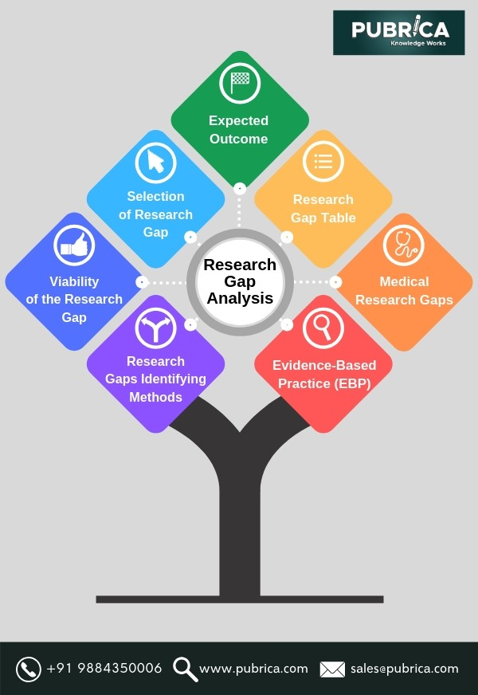
RESEARCH GAPS
Despite significant advancements, existing obesity prediction models face critical limitations.
Most studies lack dynamic, real-time capabilities and fail to incorporate evolving health behaviors.
The role of mental health in obesity risk remains underexplored, and socio-economic disparities are often overlooked. Few
models consider ethical concerns regarding AI
implementation, particularly related to privacy
and bias.
Additionally, there is a dearth of research
focusing on participatory health strategies that
actively involve adolescents in decision-making
processes.
Review No.
Department of CSE

Slide 9
RESEARCH GAPS
Current literature often overlooks the role of mental health and its impact on obesity risk among adolescents, indicating a need for more comprehensive approaches.
Few studies have explored the effectiveness of gender-specific interventions in reducing obesity rates among adolescents.
There is a scarcity of research examining the impact of socio-economic status on obesity risk prediction models, which could enhance their accuracy.
The involvement of adolescents in the development and implementation of health interventions is under-researched, limiting the effectiveness of programs.
There is a need for more studies that assess the impact of community-based interventions on adolescent obesity rates.
Research on the ethical implications of using AI and machine learning in health predictions, particularly concerning privacy and data security, is limited.
Review No.
Department of CSE

Slide 10
PROBLEM STATEMENT
There is insufficient understanding of the specific risk factors contributing to obesity in different demographic groups, particularly regarding gender differences.
Many existing studies do not adequately address the role of mental health and socio-economic factors in obesity risk, limiting the comprehensiveness of predictive models.
The lack of engagement of adolescents in their own health management results in lower effectiveness of obesity prevention strategies.
Traditional methods of data collection and analysis are often outdated, failing to leverage advanced technologies such as machine learning and AI for improved predictions.
Review No.
Department of CSE

Slide 11
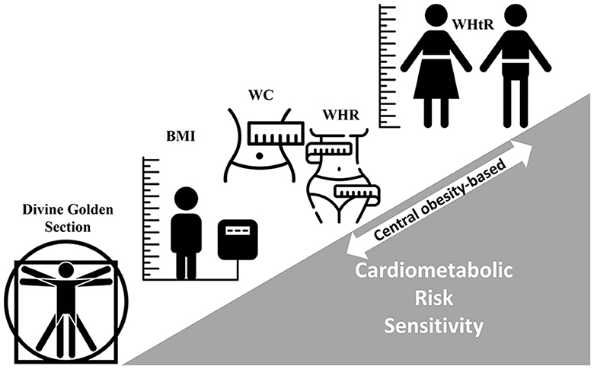
PROBLEM STATEMENT
There is a critical need for tailored interventions that consider individual lifestyle factors and preferences to effectively combat adolescent obesity.
The ethical implications of using AI in health predictions, including concerns about data privacy and security, remain underexplored.
Review No.
Department of CSE

Slide 12
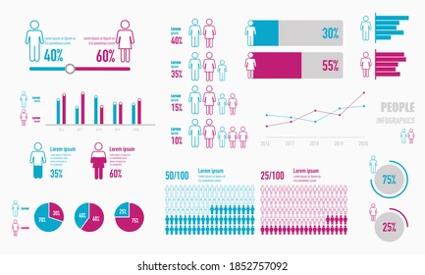
OBJECTIVES
Assess the Prevalence and Trends of Adolescent Obesity: This objective aims to analyze current data on obesity rates among adolescents, focusing on demographic factors such as age, gender, and socio-economic status. Understanding these trends is crucial for identifying at-risk populations and tailoring interventions effectively.
Review No.
Department of CSE

Slide 13
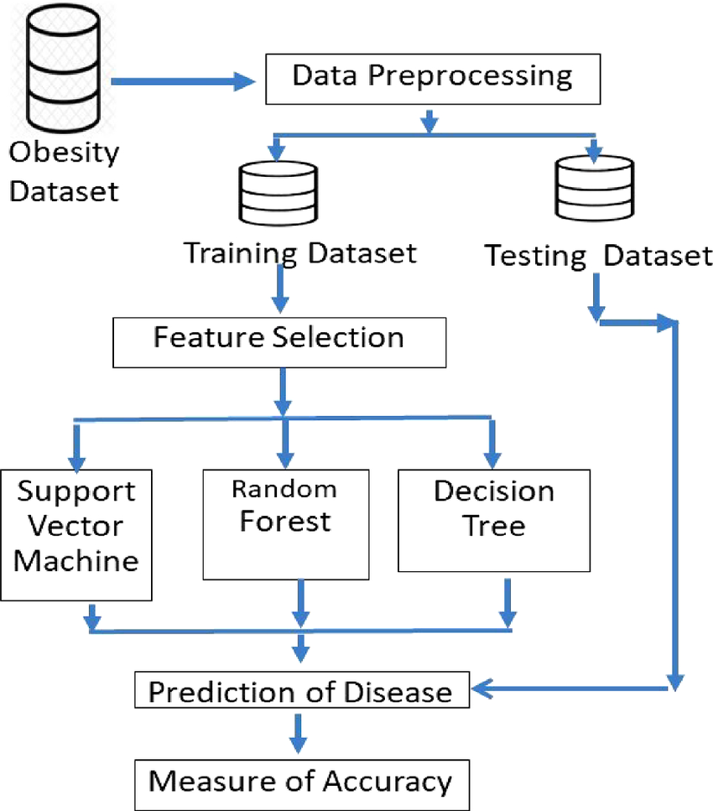
OBJECTIVES
Develop a Predictive Model for Obesity Risk: The goal is to create a machine learning model that utilizes various health metrics, including BMI, waist circumference, and lifestyle factors, to predict obesity risk in adolescents. This model will enhance the accuracy of risk assessments and facilitate early intervention strategies.
Review No.
Department of CSE

Slide 14
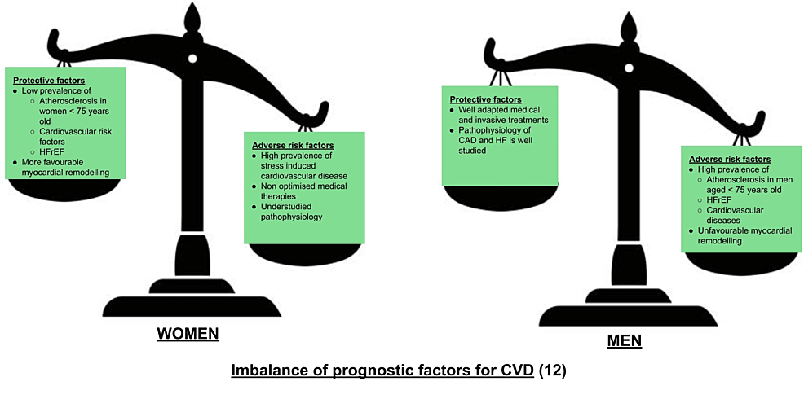
OBJECTIVES
Investigate Gender-Specific Risk Factors: This objective focuses on exploring the differences in obesity risk factors between male and female adolescents. By understanding these gender-specific influences, the project aims to inform targeted intervention strategies that address the unique needs of each group, ultimately improving health outcomes.
Review No.
Department of CSE

Slide 15
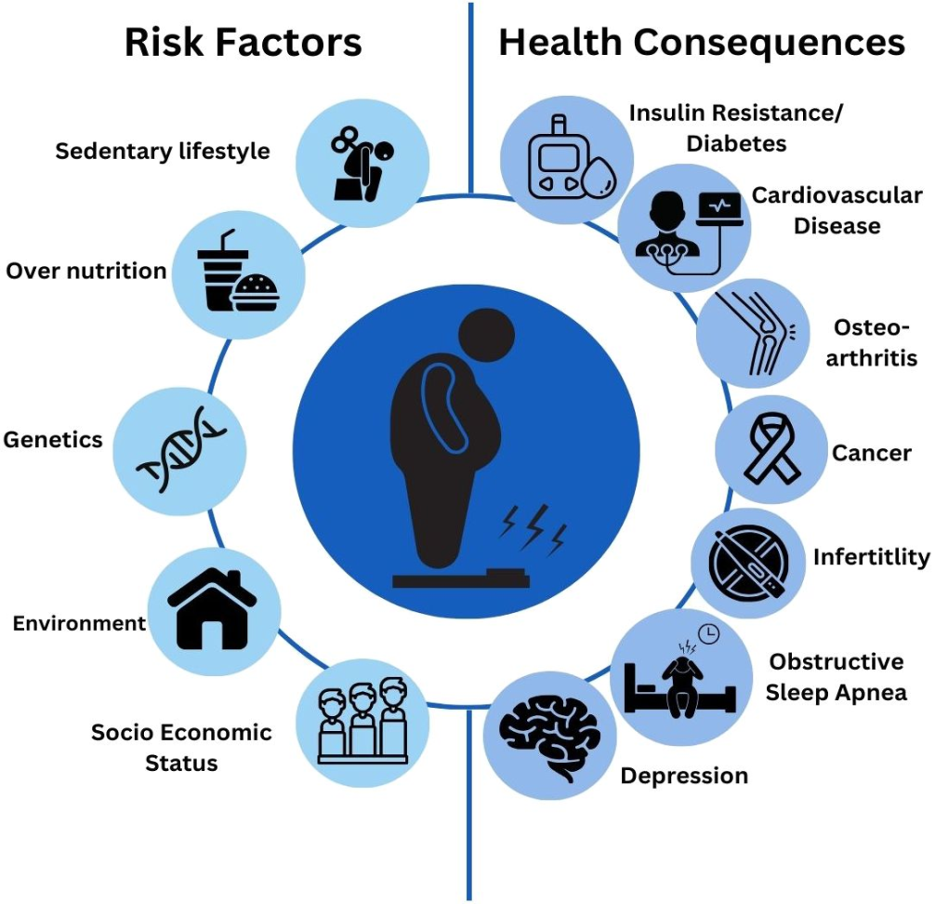
OBJECTIVES
Engage Adolescents in Health Management: This objective emphasizes the importance of involving adolescents in their own health care and decision-making processes. By incorporating participatory research methods, the project seeks to empower young individuals to take an active role in managing their health, leading to more effective and sustainable obesity prevention strategies.
Review No.
Department of CSE

Slide 16
Dataset
Dataset Overview:
The dataset aims to classify obesity risk levels by analyzing various features related to an individual's health, behavior, and demographics.
It containsAge, Gender, Height, Weight, Body Mass Index (BMI), Waist Circumference(WC) ,Dietary habits, Physical activity levels, Sleep duration, Socioeconomic status
Availability: You can find the dataset titled "Multi-Class Prediction of Obesity Risk" on Kaggle at the following link:
https://www.kaggle.com/code/ucupsedaya/90-bayesianoptimization-meta-learning-s4e2-comp/input
Review No.
Department of CSE

Slide 17
PREPROCESSING
Example (before and after scaling):
Data Collection:
Health metrics collected included:Height.Weight,BMI
Daily physical activity (steps taken),Dietary intake (caloric intake)
1.Data Cleaning and Formatting:
Conversion:Convert units(height: cm → meters, weight: grams → kg).
Normalization:Encode categorical variables (e.g., activity level: low, moderate, high → 0,1,2).
Standardization: Ensure uniform date/time formats.
Method Used:Pandas (Python), NumPy for data transformation.
Height (cm) | Weight (kg) | Age | Scaled Height | Scaled Weight | Scaled Age
170 | 75 | 25 | 0.65 | 0.55 | 0.40
160 | 65 | 30 | 0.45 | 0.35 | 0.60
Review No.
Department of CSE

Slide 18
PREPROCESSING
2.Handling Missing Values:
Mean/Median Imputation – Fill missing BMI, weight, or height with average values.
K-Nearest Neighbors (KNN) Imputation – Predict missing values using nearest records.
Forward/Backward Fill– Use previous or next available data points.
Methods Used: SimpleImputer (from Scikit-learn) for mean imputation.
Example Table (Before & After Encoding):
Gender | Obesity Level (Target) | Encoded Gender | Encoded Obesity Level
Male | Overweight | 1 | 2
Female | Normal Weight | 0 | 1
Review No.
Department of CSE

Slide 19
PREPROCESSING
3.Outlier Detection and Treatment:
Z-Score Method: Identify extreme values beyond ±3 standard deviations.
Interquartile Range (IQR): Remove values outside 1.5 * IQR range.
Isolation Forest Algorithm: Detect anomalies using ML.
Methods Used:
SciPy stats (z-score analysis).- Pandas & NumPy (IQR filtering)
4. Data Transformation and Feature Engineering
Feature Scaling:
Min-Max Scaling: Rescale values between 0 and 1.
Standardization: Transform data to mean = 0, standard deviation = 1.
Feature Creation:
BMI Calculation → \( \frac{\text{weight (kg)}}{\text{height (m)}^2} \)
Caloric Balance = Calories Intake – Calories Burned.
Activity Score= Combination of steps, exercise duration, and intensity.
Review No.
Department of CSE

Slide 20
PREPROCESSING
Methods Used:
Scikit-learn StandardScaler & MinMaxScaler for normalization.
Feature Engineering with Pandas & NumPy for derived features.
5. Handling Class Imbalance:
SMOTE (Synthetic Minority Over-sampling Technique):Creates synthetic examples for minority classes.
Weighted Loss Functions: Adjust model training to give higher weight to underrepresented classes.
Methods Used:
Imbalanced-learn library (SMOTE algorithm).
Scikit-learn class_weight parameter in model training.
Review No.
Department of CSE

Slide 21
PREPROCESSING
6. Time-Series Data Formatting:
Resampling for daily/weekly intervals for trend analysis.
Aggregation (e.g., average calorie intake per week, total steps per day).
Ensure consistent time gaps for sequential models like LSTM.
Methods Used:
Pandas resample() for time-series aggregation.
NumPy mean() & rolling() functions for smoothing trends.
7. Final Data Validation :
Ensure no missing values remain.
Verify data consistency across different features.
Generate visualizations (histograms, box plots) for anomaly detection.
Methods Used:
Matplotlib & Seaborn for visualization.
Pandas describe() & info() to check dataset quality.
Review No.
Department of CSE

Slide 22
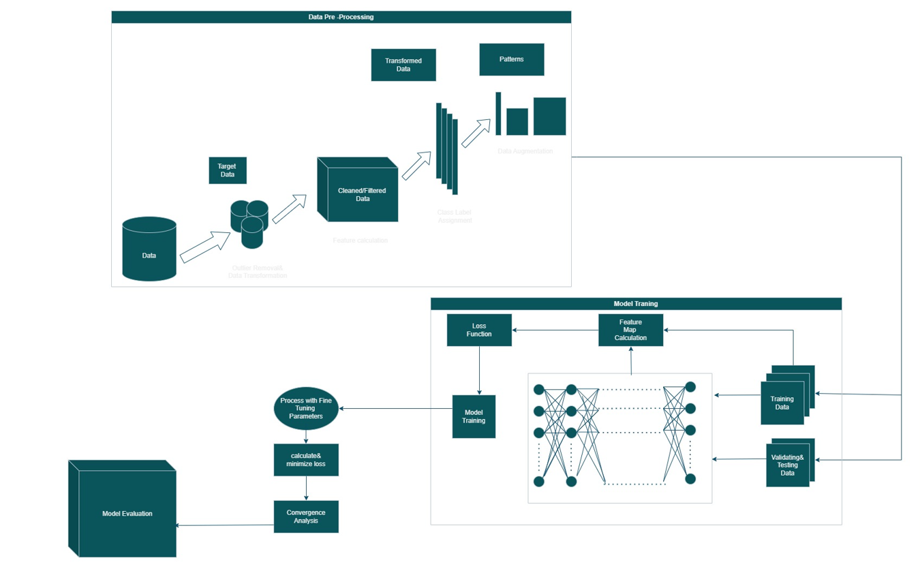
BLOCK DIAGRAM OR FLOW DIAGRAM
Review No.
Department of CSE

Slide 23
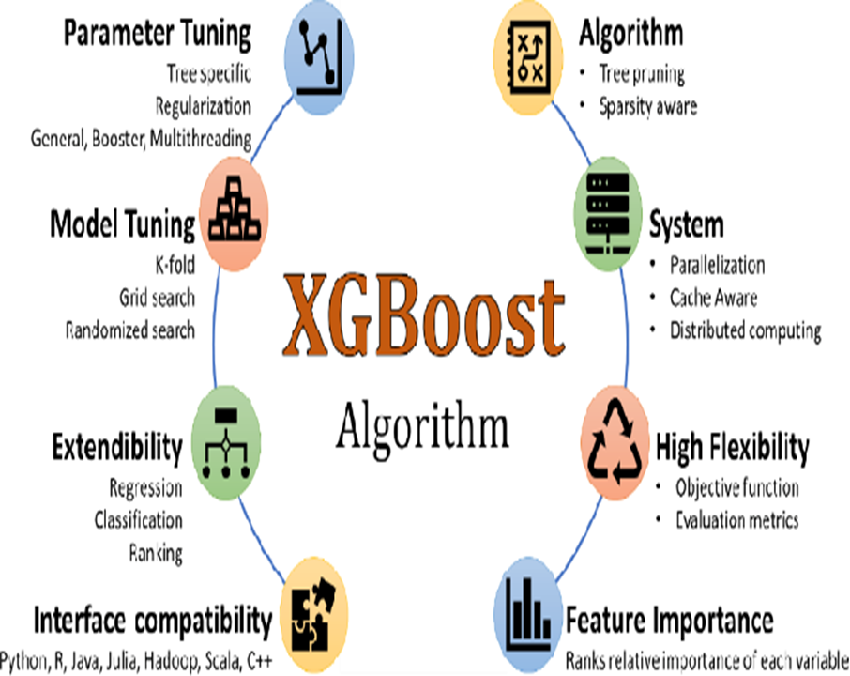
XG BOOST MODEL
XGBoost classifies adolescents into obesity categories (underweight, normal weight, overweight, obese) using features like age, height, weight, and dietary habits.
It captures non-linear relationships in health data, such as how physical activity impacts BMI differently across genders, without the need for manual adjustments.
XGBoost identifies key predictors of obesity, such as BMI (0.35 importance), waist circumference (0.30), and caloric intake (0.20), guiding health interventions.
It uses techniques like regularization and early stopping to prevent overfitting, ensuring that the model performs well on new, unseen data through thorough validation practices.
Review No.
Department of CSE

Slide 24
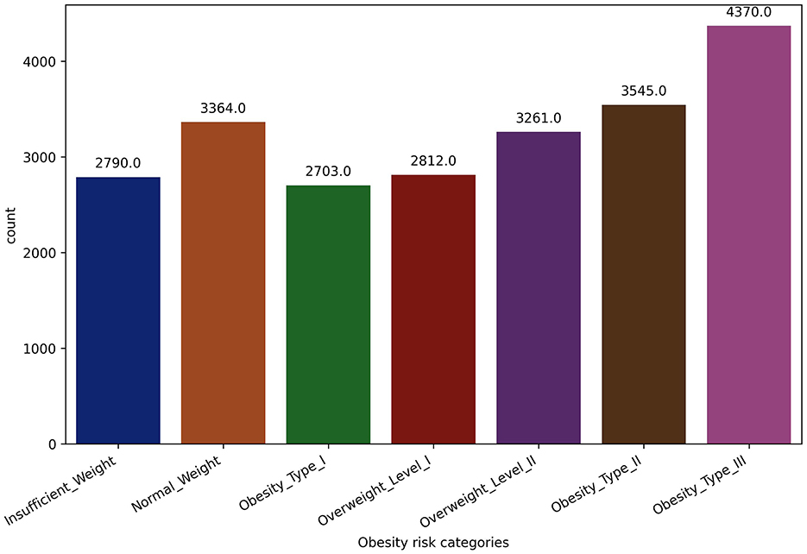
RESULTS & ANALYSIS
Predictive Model Accuracy
Overall Model Accuracy: 0.96
Gender-Specific Accuracies:
Boys: 0.9561
Girls: 0.9423
Review No.
Department of CSE

Slide 25
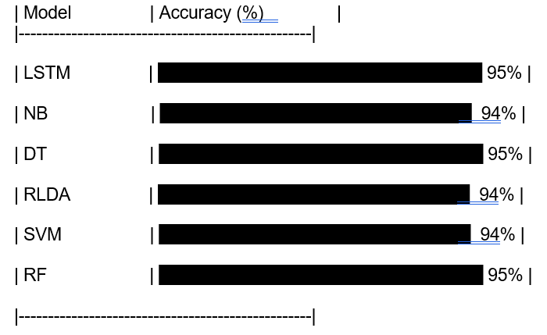
RESULTS & ANALYSIS
Comparative Analysis with Other Models:
DeepHealthNet outperformed:
LSTM: 0.9542, lower accuracy than DeepHealthNet.
RLDA: Accuracy of 0.9448, slightly higher than DeepHealthNet but less robust in other metrics.
Support Vector Machine (SVM): Accuracy of 0.9446, close to Logistic Regression but slightly behind in overall reliability.
Review No.
Department of CSE

Slide 26
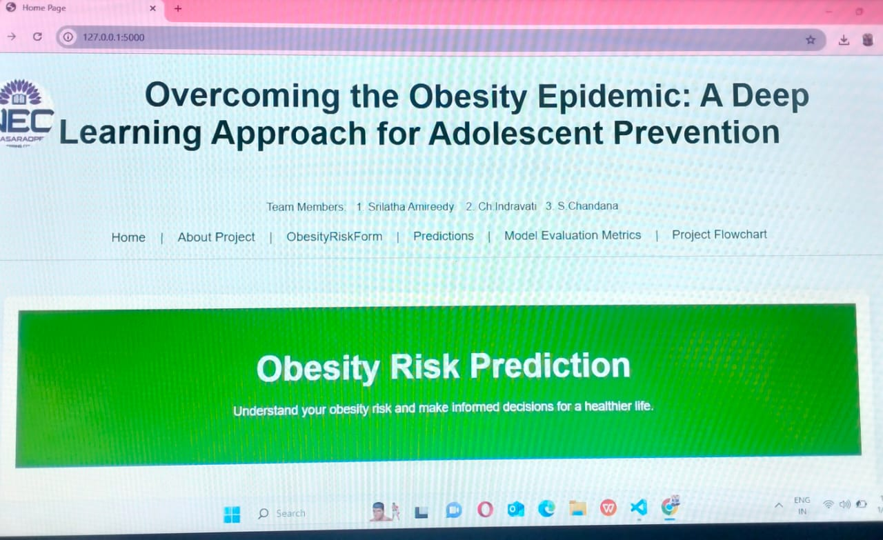
HOME PAGE
Review No.
Department of CSE

Slide 27
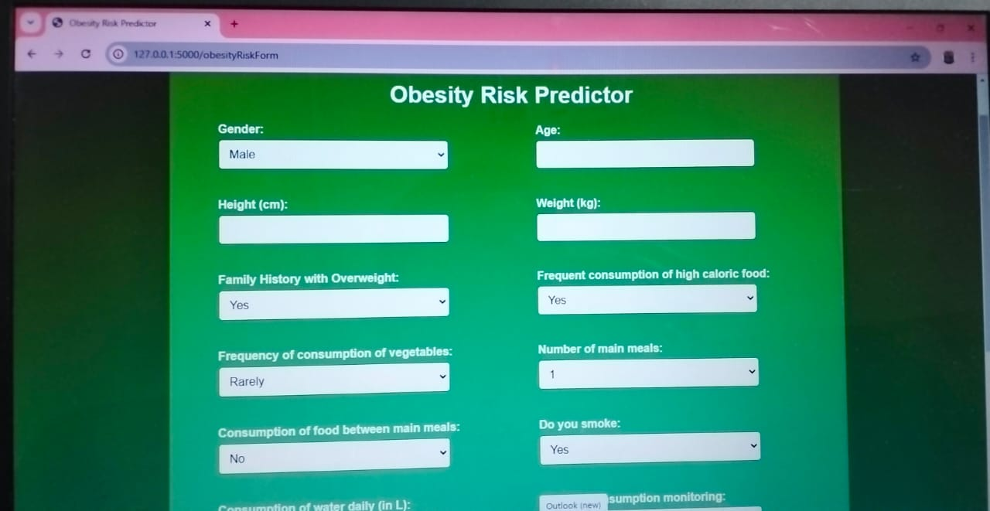
PREDICTION PAGE
Review No.
Department of CSE

Slide 28
CONCLUSION and FUTURE SCOPE
The study successfully identified critical risk factors for adolescent obesity, emphasizing the importance of BMI and waist circumference.The predictive model demonstrated high accuracy (0.96), validating its effectiveness in identifying at-risk adolescents.
The use of advanced machine learning techniques provided robust predictions, outperforming traditional models.Statistical significance of results (p < 0.001) reinforces the reliability of the findings.
Utilize larger datasets to improve model accuracy and generalizability.
Focus on community-based initiatives to promote healthy lifestyles among adolescents.
Review No.
Department of CSE

Slide 29
REFERENCES
World Health Organization (WHO). (2021). Global report on obesity and overweight in children and adolescents. Retrieved from WHO website
Topol, E. J. (2019). High-performance medicine: the convergence of human and artificial intelligence. Nature Medicine, 25(1), 44-56. 2013,57, 189–193. [CrossRef] [PubMed]
Obermeyer, Z., & Emanuel, E. J. (2016). Predicting the future—big data, machine learning, and clinical medicine. The New England Journal of Medicine, 375(13), 1216-1219.2007,29, 129–143. [CrossRef] [PubMed]
Lissner, L., Lange, C., Mehlig, K., & Sjöberg, A. (2018). Gender differences in the association between BMI and self-rated health in a Swedish population: A 10-year follow-up of the Västerbotten Intervention Programme. Scandinavian Journal of Public Health, 46(2), 176-184.
Reddy, S., Fox, J., & Purohit, M. P. (2019). Artificial intelligence-enabled healthcare delivery. JAMA, 321(24), 2403-2404.
Review No.
Department of CSE

Slide 30
REFERENCES
Shapiro, S. S., & Wilk, M. B. (1965). An analysis of variance test for normality (complete samples). Biometrika, 52(3/4), 591-611. https://doi.org/10.1093/biomet/52.3-4.591
Rao, C. R. (1973). Linear Statistical Inference and Its Applications (2nd ed.). Wiley.
He, H., & Garcia, E. A. (2009). Learning from imbalanced data. IEEE Transactions on Knowledge and Data Engineering, 21(9), 1263-1284. https://doi.org/10.1109/TKDE.2008.239
Box, G. E. P., Jenkins, G. M., & Reinsel, G. C. (2015). Time Series Analysis: Forecasting and Control (5th ed.). Wiley.
Manning, C. D., Raghavan, P., & Schütze, H. (2008). Introduction to Information Retrieval. Cambridge University Press.
Breiman, L., Friedman, J., Olshen, R. A., & Stone, C. J. (1986). Classification and Regression Trees. Wadsworth & Brooks/Cole.
Review No.
Department of CSE

Slide 31

QUESTIONS and ANSWERS
Your Insights Matter!
Review No.
Department of CSE

Slide 32

ACKNOWLEGEMENTS
A Heartfelt Thank You
To Our Guide:Gaddam Saranya
To Our Coordinator:Dodda Venkatareddy
From:
Srilatha Amireddy (srilathaamireddy123@gmail.com)
Chinni Indravati (indravathichinni5@gmail.com)
Sripati Chandana (sripathichandana2@gmail.com)
Review No.
Department of CSE

